Slide 1
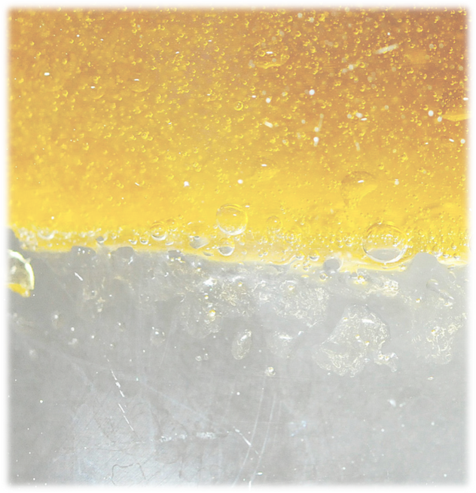
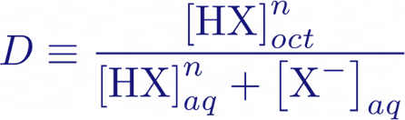
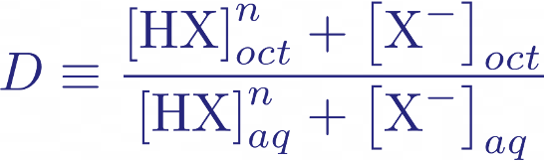
Organic Phase
(a)
(b)
Organic Phase
Aqueous Phase
Aqueous Phase

